Slide 1

Annotating entity types in the Taiwan Mandarin corpus

Slide 2
Entity type
Human (including 擬人)
Organization
Animal
Plant
Thing
Body-part
Substance
Location
Date-time
Number (other than quantity, e.g. 一號)
Quantity
Event
Word (referring to a word, e.g. 這個單詞)
Abstract (e.g. 誠實, 數學)

Slide 3

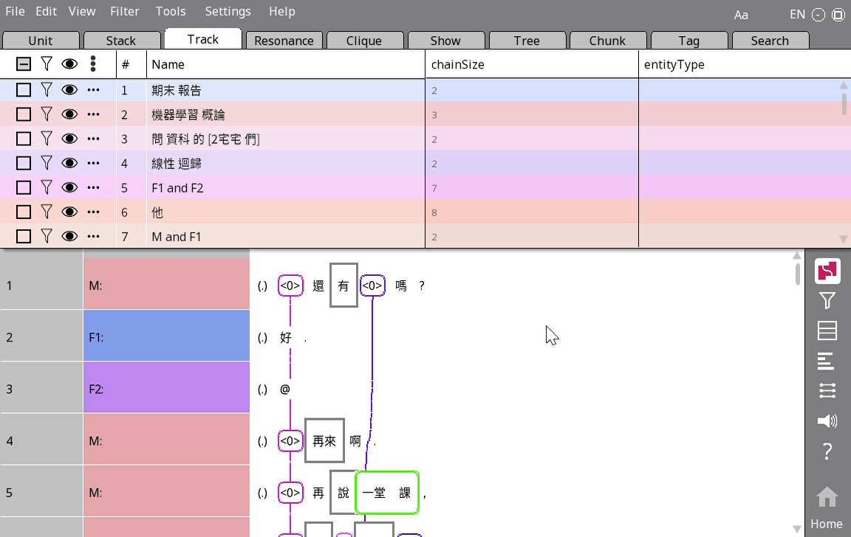
Annotation process
Go to the Track tab
Make sure you’re in one to one mode
Annotate in the track pane:

